Slide 1
Advance Software Engineering
Estimating Duration and Cost

Slide 2
The Steps in Estimating
Step 1. Establish Cost-Estimation Objectives
Step 2a. Develop a Plan for Estimation Activities
Step 2b. Plan for Resources
Step 3. Clarify Software Requirements
Step 4. Explore as Much Detail as Feasible
Step 5. Use Several Independent Techniques
Step 6. Compare, Understand, and Iterate Estimates
Step 7. Review Estimate Accuracy

Slide 3
COCOMO: A Regression Model
Regression Models in General
A regression model is derived from a statistical interpretation of historical data to describe a mean or "typical" relationship between variables.

Slide 4
Organic
The organic mode is typified by systems such as payroll, inventory, and scientific calculation. Other characterizations are that the
  Project team is small,
  Little innovation is required,
  Constraints and deadlines are few,
  The development environment is stable.
Semidetached
The semidetached mode is typified by utility systems such as compilers, database systems, and editors. Other characterizations are that the
  Project team is medium-size,
  Some innovation is required,
  Constraints and deadlines are moderate,
  The development environment is somewhat fluid.
Embedded
The embedded mode is typified by real-time systems such as those for air traffic control, ATMs, or weapon systems. Other characterizations are that the
  Project team is large,
  A great deal of innovation is required,
  Constraints and deadlines are tight,
  The development environment consists of many complex interfaces, including those with hardware and with customers.

Slide 5
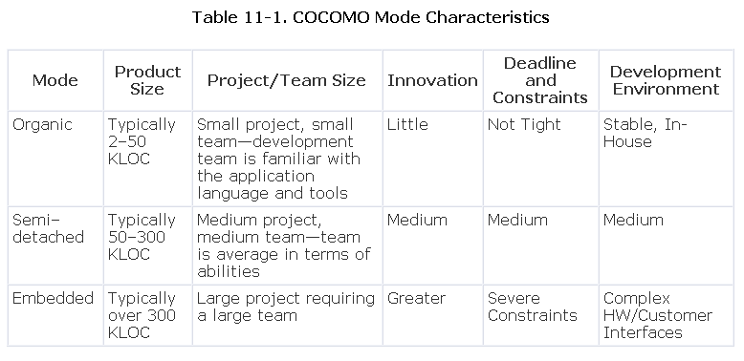

Slide 6
COCOMO Levels
Basic
This level uses only size and mode to determine the effort and schedule.
It is useful for fast, rough estimates of small to medium-size projects.
Intermediate
This level uses size, mode, and 15 additional variables to determine effort.
The additional variables are called "cost drivers" and relate to product, personnel, computer, and project attributes that will result in more effort or less effort required for the software project.
The product of the cost drivers is known as the environmental adjustment factor (EAF).
Detailed
This level builds upon intermediate COCOMO by introducing the additional capabilities of phase-sensitive effort multipliers and a three-level product hierarchy.
The intermediate level may be tailored to phase and product level to achieve the detailed level. An example of phase-sensitive effort multipliers would be consideration of memory constraints when attempting to estimate the coding or testing phases of a project.
At the same time, though, memory size may not affect the effort or cost of the analysis phase. This will become more obvious after the effort multipliers (or cost drivers) are described.
Phase-sensitive multipliers are generally reserved for use in mature organizations and require the use of an automated tool.

Slide 7
Detailed (cont)
A three-level product hierarchy consists of system, subsystem, and module, much like the arrangement of a WBS.
Large projects may be decomposed into at least three levels so that each of the cost drivers introduced in intermediate COCOMO is assigned to that level likely to be most influenced by variations in the cost driver.
For example, an engineer's language experience may apply only at the module level, an analyst's capability may apply at a subsystem level and a module level, and required reliability may apply at the system, subsystem, and module level.
As with the phase-sensitive multipliers, this will make more sense after the cost drivers are described. As with the phase-sensitive multipliers, mature organizations with automated tools are the heaviest users.

Slide 8
Basic COCOMO
Effort Estimation
KLOC is the only input variable. An exponential formula is used to calculate effort.
COCOMO Basic Effort Formula
Effort (E) = a x (Size)^{b}
Where
a and b = constants derived from regression analysis (depends on the project)
Size = thousands of lines of code (KLOC)
E = effort expressed in staff-months

Slide 9
Mode/Coeffecients | a | b | c | d
Organic | 2.4 | 1.05 | 2.5 | 0.38
Semi Detached | 3.0 | 1.12 | 2.5 | 0.35
Embedded | 3.6 | 1.20 | 2.5 | 0.32

Slide 10
Basic COCOMO Effort Formulas for Three Modes
200kloc calculate effort ?
Effort for Organic Mode: E = 2.4 x (Size)^{1.05} 625
Effort for Semidetached Mode: E = 3.0 x (Size)^{1.12} 14937
Effort for Embedded Mode: E = 3.6 x (Size)^{1.20} 32925

Slide 11
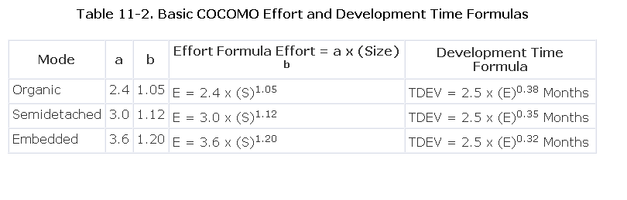

Slide 12
Basic COCOMO Average Staff Estimate
When effort (E) and development time (TDEV) are known, the average staff size (SS) to complete the project may be calculated.
Average Staff: SS = Effort/TDEV

Slide 13
Basic COCOMO Average Staff and Productivity Estimation
The productivity level may be calculated.
Productivity: P = Size/Effort

Slide 14
Basic COCOMO Example 1
A development project is sized at 7.5 KLOC and is evaluated as being simple—in the organic mode.
The basic COCOMO equation for effort (E) in staff-months (SM) is:
Effort (SM) = 2.4(KLOC)^{1.05} = 2.4(7.5)^{1.05}
= 2.4(8.49296) = 20 staff-months
Development time (TDEV):
TDEV = 2.5(SM)0.38 = 2.5(20)^{0.38} = 2.5(3.1217) = 8 months
The average number of staff members (S):
Staff = Effort/TDEV = 20 staff-months/8 months
= 2.5 staff members on average
The productivity rate (P):
Productivity = Size/Effort = 7,500 LOC/ 20 staff-months
= 375 LOC/staff-month

Slide 15
Basic COCOMO Example 2
A development project is estimated to be about 55 KLOC when complete and is believed to be of medium complexity. It will be a Web-enabled system with a robust back-end database. It is assumed to be in the semidetached mode.
For a rough estimate of the effort that will be required to complete the project, use the formula:
E (effort in staff-months) = 3.0(KLOC)^{1.12}
E (effort in staff-months) = 3.0(55)^{1.12}
E = 3.0(88.96)
E = 267 staff-months

Slide 16
Example 2 (cont)
To determine how long it will take to complete the project, use the formula:
TDEV = 2.5 x (E)0.35
TDEV = 2.5 x (267)0.35
TDEV = 2.5(7.07)
TDEV = 17.67 months
To obtain a rough estimate of how many developers will be needed, use the formula:
S (average staff) = effort÷TDEV
S (average staff) = 267÷17.67
S (average staff) = 15.11
To determine a rough estimate of the productivity rate, use the formula:
P (productivity) = size÷effort
P (productivity) = 55,000÷267
P (productivity) = 206 LOC/staff-month

Slide 17
Basic COCOMO Phase Distribution of Effort and Schedule
In addition to estimating development effort and schedule, it is often necessary to estimate how the effort is distributed among the primary life cycle activities. COCOMO takes a pretty simplistic view of the life cycle phases, considering only plans and requirements, product design, coding, and integration and test as the four development phases, and maintenance as the final life cycle phase.

Slide 18
Example of phase distribution of effort and schedule.
Let's look at an example of phase distribution of effort and schedule.
Suppose that an embedded mode project is sized at 80 KLOC.
E (effort in staff-months) = 3.6(KLOC)^{1.20} = 3.6(80)^{1.20} = 3.6(192.18) = 692 staff-months
TDEV (development time) = 2.5(E)0.32 = 2.5(692)0.32 = 2.5(8.106) = 20 months

Slide 19
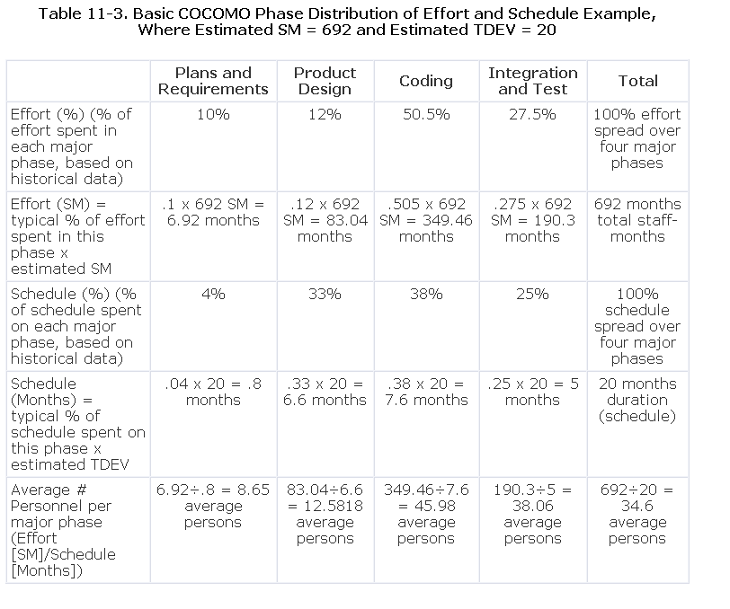

Slide 21
Intermediate COCOMO
Intermediate COCOMO uses size and modes just like the basic model, plus 15 additional variables called cost drivers. The idea is that there are characteristics of a given project that drive the cost (effort) up or down.

Slide 22
Intermediate COCOMO Formula
Effort (E) = a x (Size)^{b} x C
Effort for Organic Mode: E = 3.2 x (Size)^{1.05} x C
Effort for Semidetached Mode: E = 3.0 x (Size)^{1.12} x C
Effort for Embedded Mode: E = 2.8 x (Size)^{1.20} x C

Slide 23
Cost Drivers
The concept of the effort adjustment factor (EAF) is that it has the effect of increasing or decreasing the effort, and therefore cost, depending on a set of environmental factors. These environmental factors are also known as cost adjustment factors [Cis], or cost drivers. There are two steps in determining this multiplying factor:
  Step 1. is to assign numerical values to the cost drivers.
  Step 2. is to multiply the cost drivers together to generate the effort adjustment factor, C.
  When multiplied together, the cost adjustment factors can affect project cost and schedule estimates by 10 times or more!

Slide 24
Product of Cost Drivers Is the Effort Adjustment Factor
EAF = C1 x C2 x . . . x Cn
Ci = 1 implies the cost driver does not apply
Ci > 1 implies increased cost due to this factor
Ci < 1 implies decreased cost due to this factor

Slide 25
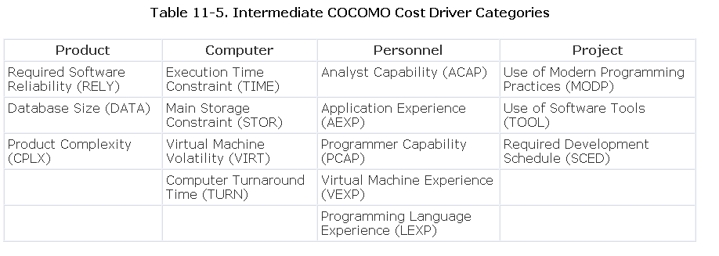

Slide 26
Other Cost Drivers
Although product, computer, personnel, and project attributes are the four categories that are commonly associated with applications of the intermediate COCOMO model, additional attributes are often added by a project manager aware of other organizational (or project) strengths and/or weaknesses. Some common ones include:
Requirements volatility—some is expected, but too much can be a big problem;
Development machine volatility—unstable OS, compilers, CASE tools, and so on;
Security requirements
Access to data—sometimes very difficult;
Impact of standards and imposed methods;
Impact of physical surroundings.

Slide 27
Product of Cost Drivers
C = RELY x DATA x CPLX x TIME x STOR x VIRT x TURN x ACAP x AEXP x PCAP x VEXP x LEXP x MODP x TOOL x SCED

Slide 28
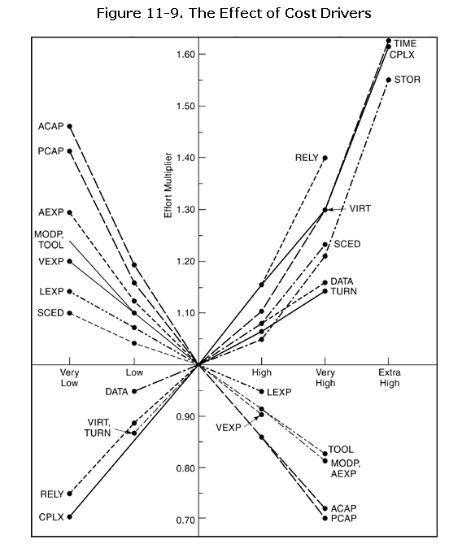

Slide 29
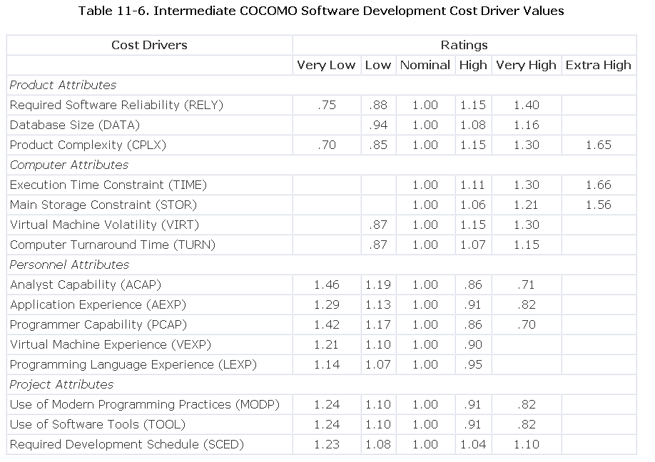

Slide 30
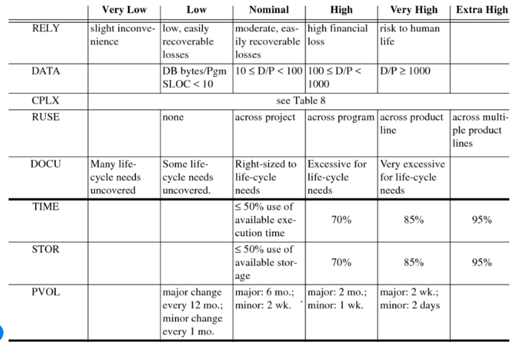
Rationale behind the assigned values of cost drivers

Slide 31
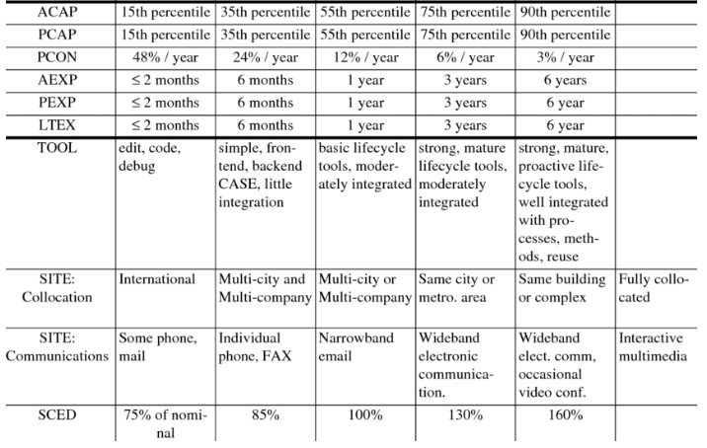
Rationale behind the assigned values of cost drivers

Slide 32
Intermediate COCOMO Example 1
A 10 KLOC embedded-mode software product is to perform communications processing functions on a commercial microprocessor.
Cost Drivers Situations Rating Value
RELY No serious recovery problem
DATA 30,000 bytes
CPLX High
TIME 70% available time
STOR 45K to 60K store (70%)
VIRT Low
TURN High
ACAP Excellent analyst
AEXP 3 years
PCAP 70th and above percentile
VEXP High
LEXP 12 months
MODP 3 years
TOOL
SCED 125%

Slide 33
Calculations
The embedded mode formula gives nominal effort:
En = 2.8(10)^{1.20} = 2.8(15.85) = 44 staff-months

Slide 34
Intermediate COCOMO Example 1 (cont)
The adjustment factor is applied to the nominal effort:
E = 2.8(10)1.20 x C = 44 x = staff-months

Slide 35
Intermediate COCOMO Example 2
Problem:
A project is estimated at 44 staff-months (SM). Using more capable personnel on the project decreases both the ACAP and PCAP ratings from nominal (1.00) to high (0.86), but the staff cost increases from $5,000 to $6,000 per SM. Assume that all other cost drivers are rated nominal (1.00).
Solution:
Effort Adjustment Factor (EAF) = C = RELY x DATA x CPLX x TIME x STOR x VIRT x TURN x ACAP x AEXP x PCAP x VEXP x LEXP x MODP x TOOL x SCED = 1.00 x 1.00 x 1.00 x 1.00 x 1.00 x 1.00 x 1.00 x 0.86 x 1.00 x 0.86 x 1.00 x 1.00 x 1.00 x 1.00 x 1.00 = 0.74
staff-month adjustment: 44 SM x 0.74 = 32.6

Slide 36
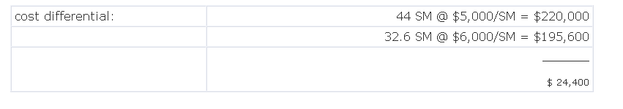
Intermediate COCOMO Example 2 (cont)
Conclusion: In this example, upgrading of the personnel more than pays
for itself in the form of overall project savings.

Slide 37
COCOMO DETAILED

Slide 38
